Slide 1
Chapter 2
FTP, SMTP, and DNS

Slide 2

File Transfer Protocol (FTP)
TCP control connection,
server port 21
FTP procedure:
FTP client contacts FTP server at port 21, using TCP
Client authorized over control connection
Client browses remote directory, sends commands over control connection
When server receives file transfer command, server opens 2nd TCP data connection (for file) to client
After transferring one file, server closes data connection
FTP
client
TCP data connection,
server port 20
FTP
server
FTP communicates over two connections
Port 21 for control information
Port 20 for data
Differences from HTTP
Control communication “out-of-band”
Server maintains per client state: authentication, current directory
Why use a separate control connection?
Notes:
So that commands don’t get stuck behind data bytes

Slide 3




Simple Mail Transfer Prot. (SMTP)
First ‘killer app’ of the Internet
SMTP procedure
Alice uses her agent to send message addressed to Bob to her server
Alice’s server tries to contact Bob’s server
Asynchronously Bob retrieves the message from his server
POP3 (Post Office Protocol) – fetch and delete
IMAP (Internet Mail Access Protocol) – maintains folder structure on server
Differences with HTTP
Much older – all content encoded as 7bit ASCII (no utf-encoded strings)
Even more verbose
SMTP primarily a push protocol, HTTP primarily pull
MAIL FROM: <mike.wittie@montana.edu>
RCPT TO: <mwittie@gmail.com>
DATA
Subject: Hello
there.
.
Communication
Alice
Bob
Data
Agent
Server
Server
Agent
Questions
Why not send the message directly between agents?
Why not have Alice’s agent contact Bob’s server directly?
How is email different from online social networks?
Notes:
telnet cs.montana.edu 25
MAIL FROM: <mwittie@cs.montana.edu>
RCPT TO: <mwittie@gmail.com>
DATA
354 Enter mail, end with "." on a line by itself
Subject: Hello
there
.
Would be synchronous
Still sort of synchronous
No subscription

Slide 4

Domain Name System (DNS)
People like mnemonics
Ex. montana.edu
Routers like fixed width addresses
Ex. 153.90.3.95
How to map between the two?
Domain Name System:
Database of mappings between host mnemonics and IP addresses
Application layer protocol
Hosts communicate with DNS to resolve names
Lookups over UDP on port 53
Example:
Client
DNS
Server
montana.edu
???
DNS lookup
153.90.3.95
Demo
Come up with an architecture for DNS
Notes:
DEMO: resolv.conf, host, and short name lookup
Come up with the architecture for DNS
Requirements
User layout
Organizations

Slide 5
DNS architecture
A distributed database
No DNS server has all the records!
Hierarchical organization
Root DNS servers
Responsible for TLD servers
Top-level domain (TLD) servers:
Responsible for com, org, net, edu
And top-level country domains, e.g.: uk, fr, ca, jp
Authoritative DNS servers:
Organization’s own DNS with up-to-date records
Root DNS Servers
com DNS servers
org DNS servers
edu DNS servers
yahoo.com
DNS servers
amazon.com
DNS servers
pbs.org
DNS servers
poly.edu
DNS servers
umass.edu
DNS servers
Local DNS servers
Not part of the hierarchy
Acts as proxy for local DNS queries
May contain cached records
Complexity at the “network edge”

Slide 6
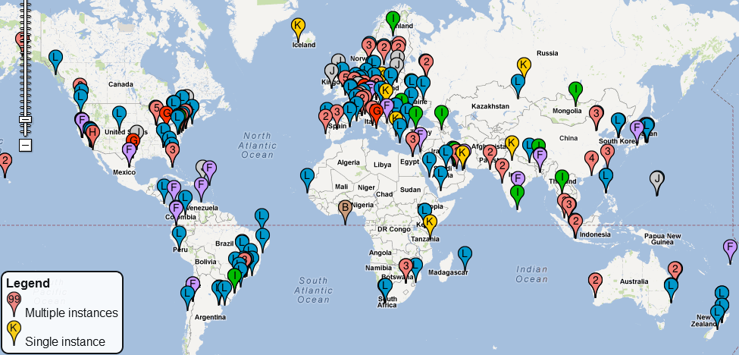
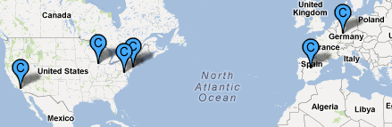
DNS root servers

Slide 7


DNS Services
DNS services
Hostname to IP address translation
host montana.edu
Hostname to IPv6 address translation
host -t AAAA montana.edu
Host aliasing
host -t CNAME img.huffingtonpost.com
Mail server aliasing
host -t MX montana.edu
Load distribution
host huffpost.com | grep "address" | sed -n -e 's/^.*address //p'
Redirection
Look up same host from servers in different regions
host google.com 8.8.8.8
montana.edu
?

Slide 8
Inserting DNS records
Want netutopia.com
Contact registrar
(eg. Network Solutions)
Provide IP of authoritative DNS
Registrar updates .com TLD
(netutopia.com, dns1.netutopia.com, NS)
(dns1.netutopia.com, 212.212.212.1, A)
Update own DNS with type A and MX records
Client
Root DNS
Registrar
TLD DNS
Authoritative DNS
netutopia.com
Web server
Mail server

Slide 9
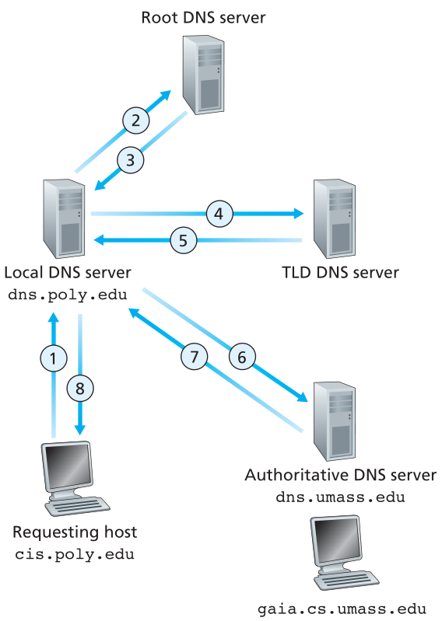
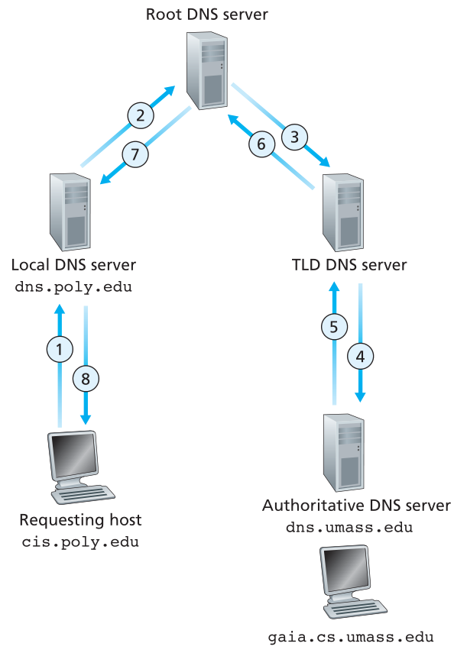
DNS lookup process
Iterative lookup
Recursive lookup
Which method is faster and why?
Notes:
Which method would be faster and why?
- Recursive because individual requests over shorter paths - Iterative, because lower queuing delay on higher up servers
DNS implemented over UDP – which system would deal better with losses?

Slide 10
DNS caching
Local DNS saves records after lookup
Host mappings
TLD addresses
Changing DNS mappings
Cache entries have time to live (TTL)
Authoritative servers push updates to TLDs through UPDATE requests
Authoritative lookup (getting around the cache)
host -t NS montana.edu
host montana.edu dns1.msu.montana.edu

